Slide 1
Sculpture Terms
& Examples
.
You will examine:
TYPES OF SCULPTURE
WAYS OF CREATING SCULPTURE
HOW THE SUBJECT IS TREATED

Slide 2
4 Types of Sculpture
Sculpture in the Round
Relief Sculpture
Environmental Sculpture
Installation sculpture

Slide 3
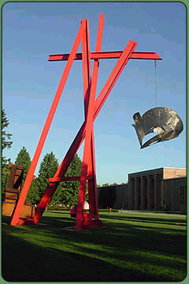
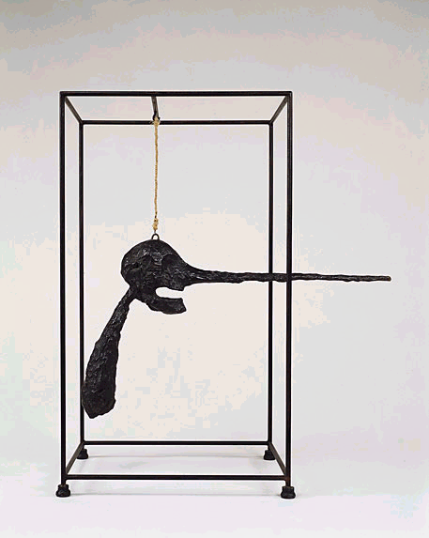
Sculpture In-The-Round

Slide 4
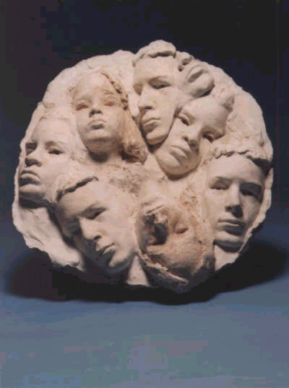
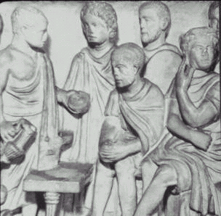
Relief Sculpture

Slide 5
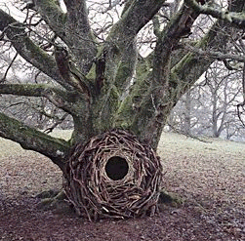
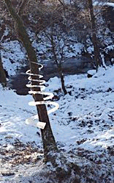
Environmental Sculpture

Slide 6
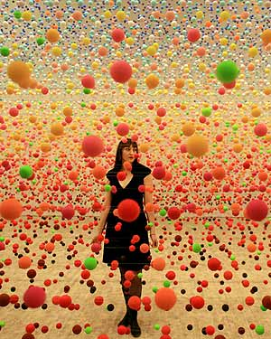
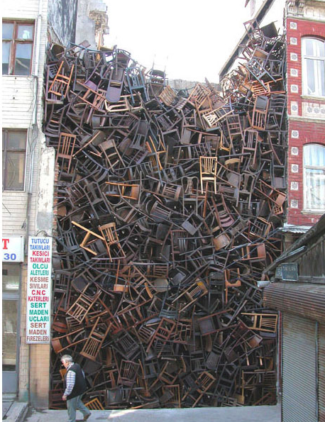
Installation Sculpture

Slide 7
Ways of Creating Sculpture:
Additive—Adding like media to create a sculpture.
Subtractive—taking away like media to release inner sculpture.
Assemblage—joining different media to make a sculpture by whatever means are appropriate.
Casting from a Mold —pouring liquid media into a negative space mold.

Slide 8
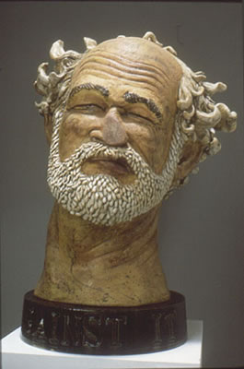
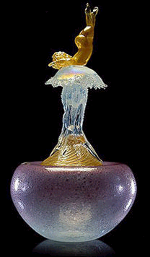
Additive

Slide 9
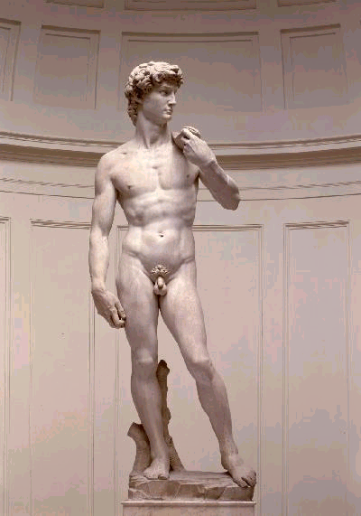
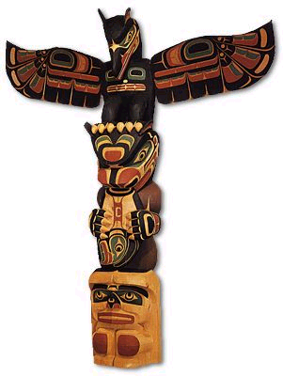
Subtractive

Slide 10
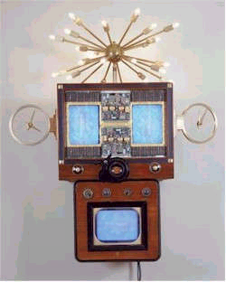
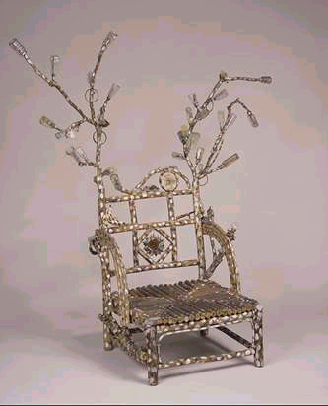
Assemblage

Slide 11
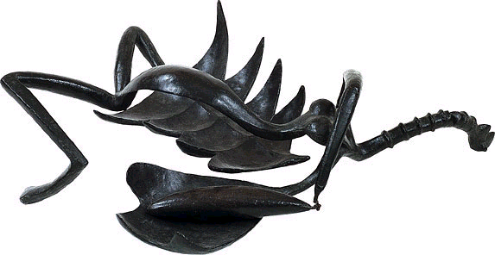
Cast from a Mold

Slide 12
How the Subject is
Treated in Sculpture:
Representational – Realistic, easily recognizable subject.
Abstract – Less realistic, stylized, but still slightly recognizeable subject.
Non-objective – Unrecognizeable subject...pure three dimensional design.

Slide 13
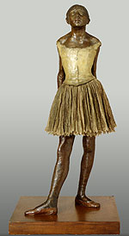
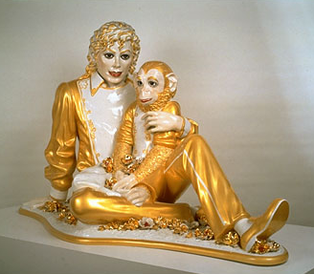
Representational
Little dancer, age 14
Michael Jackson and Bubbles

Slide 14
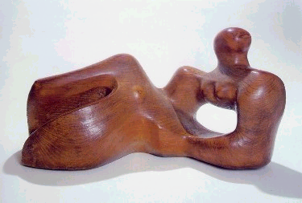
Abstract
Reclining figure

Slide 15
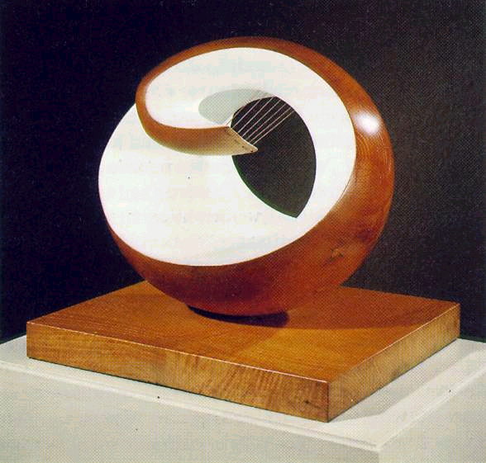
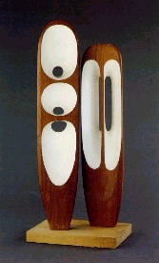
Non-Objective
Organic form #7
Harmony

Slide 16
Test your knowledge…
Study the sculpture images, one at a time.
Answer these three questions about each:
  What type of sculpture is it?
  What method was used to create it?
  How is the subject represented?

Slide 17
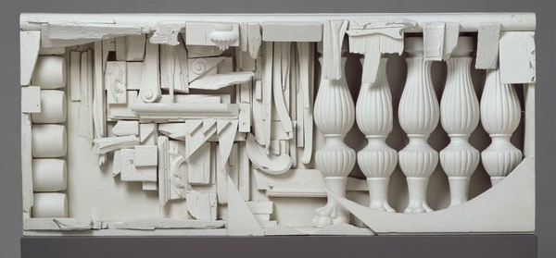
“Case with Five Posts”
Louise Nevelson, 1959, wood, metal, plastic, paint
1
  a. What type of sculpture is it?
  b. What method was used to create it?
  c. How is the subject represented?

Slide 18
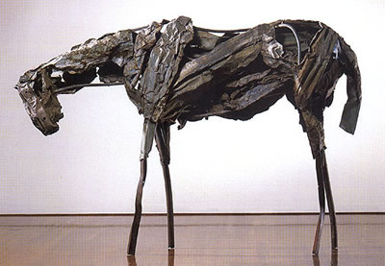
“Nehele”
Deborah Butterfield, 1988, aluminum
2
What type of sculpture is it?
What method was used to create it?
How is the subject represented?

Slide 19
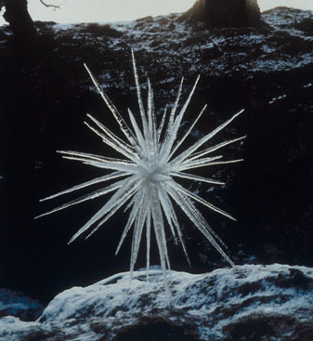
“Icicles thawed and re-frozen together”
Andy Goldsworthy, 1987, ice
3
What type of sculpture is it?
What method was used to create it?
How is the subject represented?

Slide 20
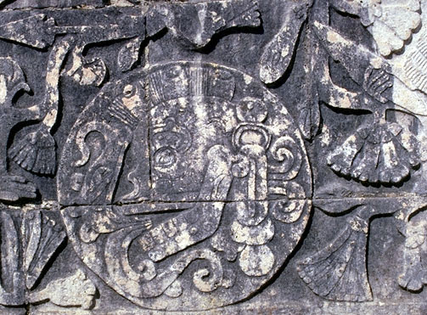
“Skull and Ball”
Late Mayan Culture, 800 AD, limestone
4
What type of sculpture is it?
What method was used to create it?
How is the subject represented?

Slide 21
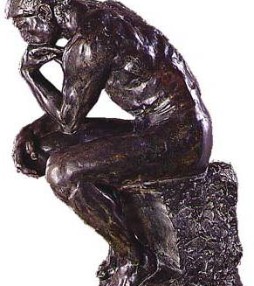
“The Thinker”
Auguste Rodin, 1880, bronze
5
What type of sculpture is it?
What method was used to create it?
How is the subject represented?

Slide 22
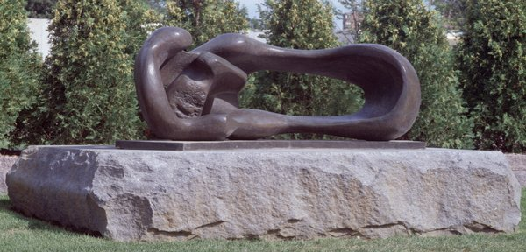
“Reclining Mother and Child”
Henry Moore, 1960, bronze
6
What type of sculpture is it?
What method was used to create it?
How is the subject represented?

Slide 23
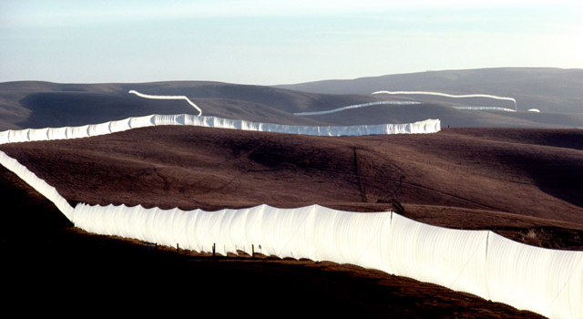
“Running Fence”
Christo and Jean-Claude, 1976, nylon and steel
7
What type of sculpture is it?
What method was used to create it?
How is the subject represented?

Slide 24
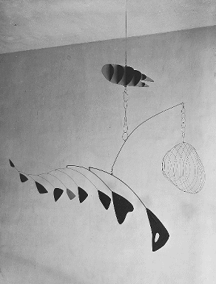
“Lobster Trap with Fish Tail”
Alexander Calder, 1939, steel wire and aluminum
8
What type of sculpture is it?
What method was used to create it?
How is the subject represented?

Slide 25
The Elements of Art
Sculpture Class Notes….
(as they relate to sculpture)
THE FOLLOWING ARE THE ELEMENTS AND EXAMPLES OF HOW EACH ELEMENT CAN BE FOUND/EMPHASIZED IN SCULPTURE

Slide 26
The Elements of Art:
The building blocks of all artwork.
Artists use the elements in different combinations to create sculpture that is successful from all sides.
Line – inner or outer contour that leads the eye through the piece.
Shape – 2D object (square, circle, etc)
Form – 3D object (cube, sphere, etc.)
Color – appearance of a surface, affected by color spectrum and absorption or reflection of light.
Texture – how something feels or looks like it would feel if
touched.
Value – highlight or shadow, causing things to appear like
they are coming forward or receding back in space.
Space – open areas in and around a sculpture.

Slide 27
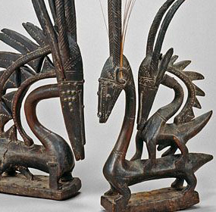
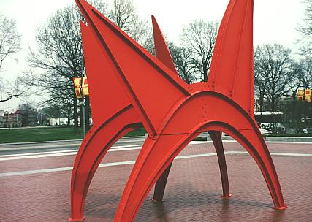
LINE
African Figural Sculpture

Slide 28
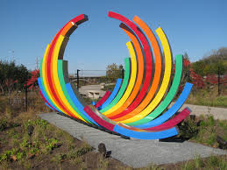
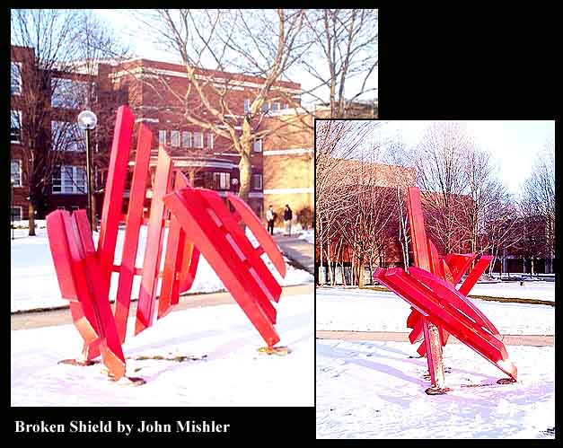
Line
“Spectral Liberation”
by Christiane Martens

Slide 29
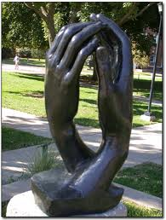
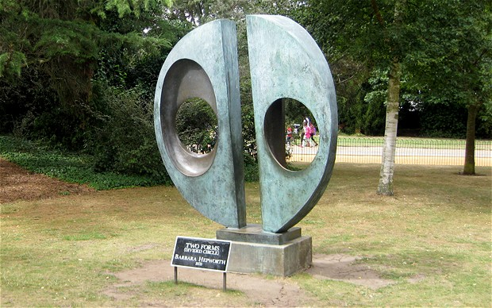
Shape (Form)
La Cathredrale
Auguste Rodin
2 Forms (Divided Circle)
Barbara Hepworth

Slide 30
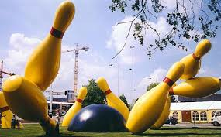
Flying Pins
Claes Oldenburg
SHAPE
(Form)
Skull and Ball”
Late Mayan Culture, 800 AD, limestone

Slide 31
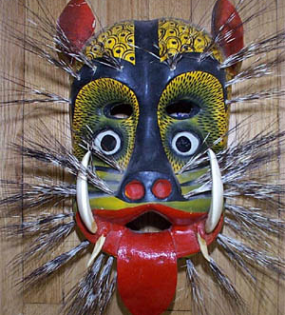
Jaquar Mask- Mexico
This jaguar mask from Mexico also emphasizes Shape. What shapes do you see? Are they Geometric, Organic or both?
Are the shapes arranged symmetrically or asymmetrically?
What shape did the artist use to accent the nose? How about the eyes?
What did the artist do to the yellow shapes that make up the skin of the jaguar?

Slide 32
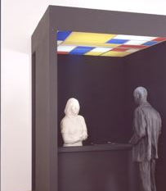
“The Hot Dog Vendor”
By George Segal
COLOR
“The Hot Dog Vendor”
By George Segal

Slide 33
CO
L
OR

Slide 34
TEXTURE
“Nehele”
Deborah Butterfield, 1988, aluminum
Icicles thawed and re-frozen together”
Andy Goldsworthy, 1987, ice

Slide 35
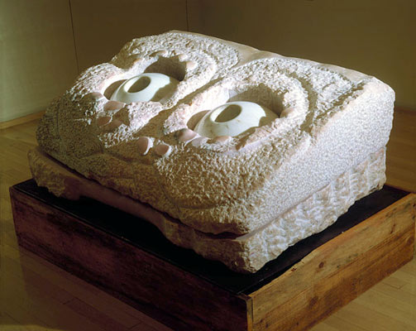
TEXTURE
“Nature Study:
Eyes”
By Louise
Bourgeois

